Slide 1
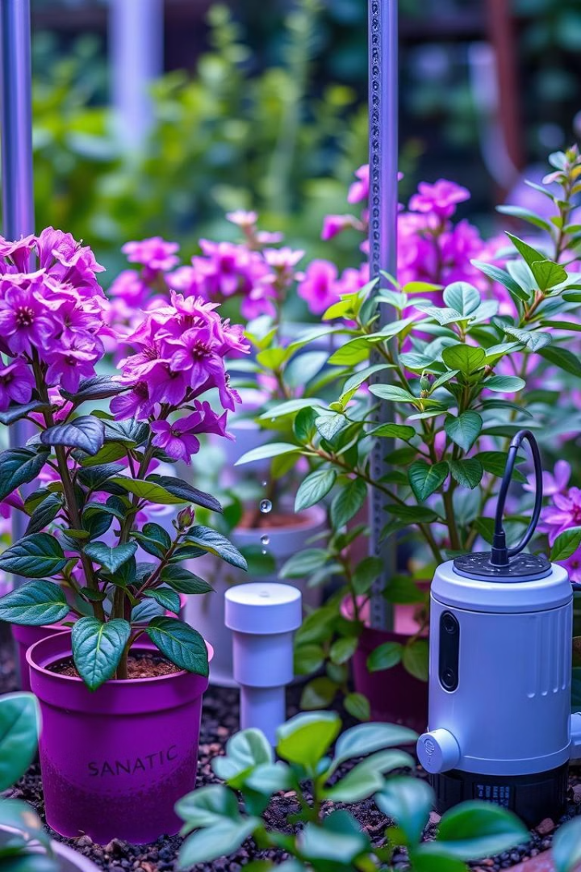
IOT Smart Plant Watering System
An IoT-Based Smart Solution for Efficient Irrigation
Presented by: Digvijay Saste 612307086,
Saurav Satpute 612307087, Jatin Mukade 612307066
Institution: College of Engineering Pune (COEP), ENTC Department

Slide 2




Introduction
Water Scarcity
Manual Methods
Water scarcity is a growing concern, especially in agriculture and horticulture.
Manual watering methods are not only time-consuming but also inefficient.
Automation Benefits
Automation can help conserve water and reduce labor, ensuring healthier plant growth.

Slide 3
Problem Statement
Traditional irrigation systems waste water due to lack of real-time control. Farmers often overwater or underwater crops, affecting productivity. There is a need for an automated, affordable system that monitors soil moisture and controls the pump efficiently. This project solves the problem using a smart irrigation system based on IoT and real-time alerts via the Blynk app.
Aim
The aim of this project is to develop a smart irrigation system using ESP8266 and Blynk that monitors soil moisture in real time and automatically controls the water pump. It helps save water, reduces manual effort, and supports better crop growth.

Slide 4
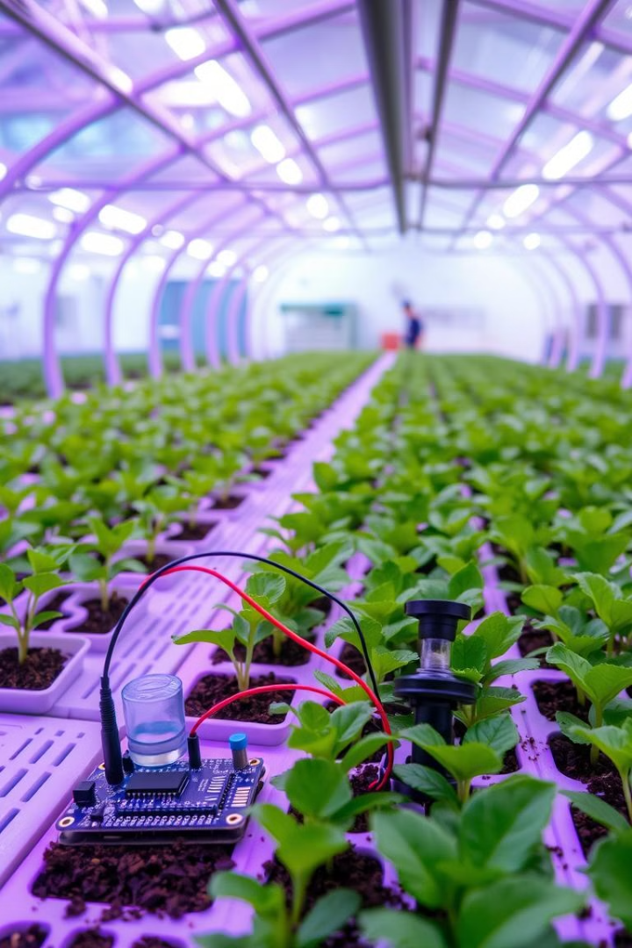




Project Overview
Automated Watering
The system automates watering based on live soil moisture levels.
Technology
Built using NodeMCU ESP8266 microcontroller and Blynk IoT platform.
Operation Modes
Offers dual operation modes – Automatic and Manual.
Real-time Alerts
Sends real-time alerts and moisture data to the user's smartphone.

Slide 5
Components Used
NodeMCU ESP8266
Soil Moisture Sensor
Relay Module
Microcontroller with WiFi support
Detects moisture level in soil
Controls water pump based on logic
Water Pump
Breadboard & Jumper Wires
Power Supply
Supplies water to plants
For connections
5V regulated supply
Blynk App
For real-time monitoring and control

Slide 6








System Architecture
Data Collection
Data Processing
Sensor reads moisture data and sends it to NodeMCU.
Data is processed and compared to a threshold (e.g., 40%).
Monitoring
Actuation
Blynk app shows moisture data and controls.
If below threshold, relay is activated to turn on the pump.
WiFi ensures seamless IoT communication.

Slide 7
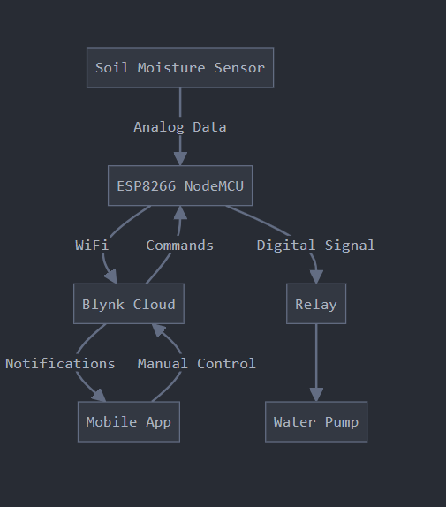
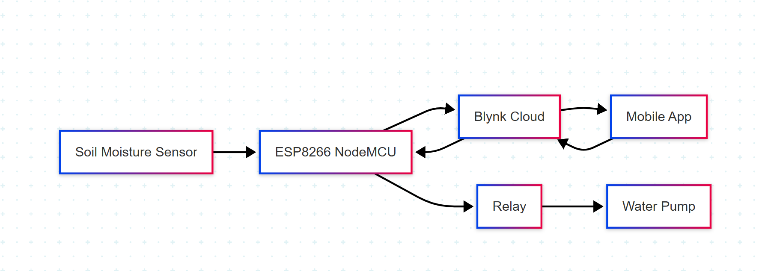
System Architecture
Flowchart/Block Diagram

Slide 8
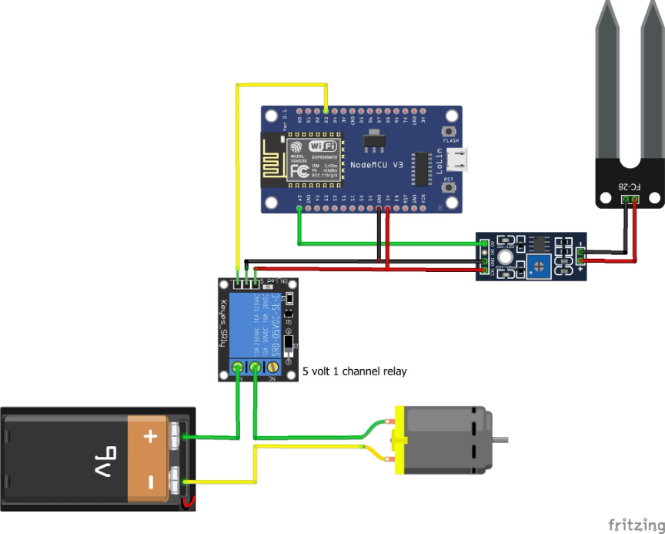
Circuit Diagram

Slide 9
Working Principle
Moisture Measurement
The Soil Moisture Sensor measures the volumetric water content in the soil and provides an analog voltage output based on dryness/wetness.
Data Conversion
The NodeMCU ESP8266 reads this analog value and converts it into a moisture percentage.
Threshold Comparison
The system checks if this value falls below a predefined threshold (e.g., 40% moisture).
Mode-based Operation
Based on the selected mode:
Automatic Mode: The system activates the relay, which powers the water pump, irrigating the soil until moisture reaches a safe level.
Manual Mode: The user is allowed to manually control the pump using the app's virtual button.
Continuous Monitoring
A real-time feedback loop ensures continuous monitoring, and the moisture values are updated every few seconds in the Blynk app.

Slide 10
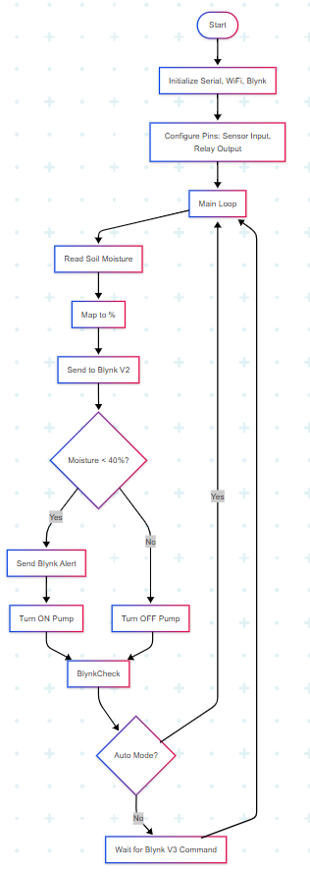
Working

Slide 11
Blynk App Integration
App Interface Components
Notification System
V2: A display widget showing the live soil moisture percentage.
When the soil moisture drops below the critical threshold (e.g., 40%), the NodeMCU triggers an alert using the Blynk.logEvent() function.
V3: A switch to manually control the pump (ON/OFF).
V4: A toggle button to select between Auto and Manual modes.
This alert is sent instantly to the user's smartphone as a push notification with a custom message (e.g., "Warning: Soil moisture too low!").
This allows users to take immediate manual action if needed, even when automatic mode is off.
Blynk enables full control and monitoring via WiFi from anywhere in the world.

Slide 12
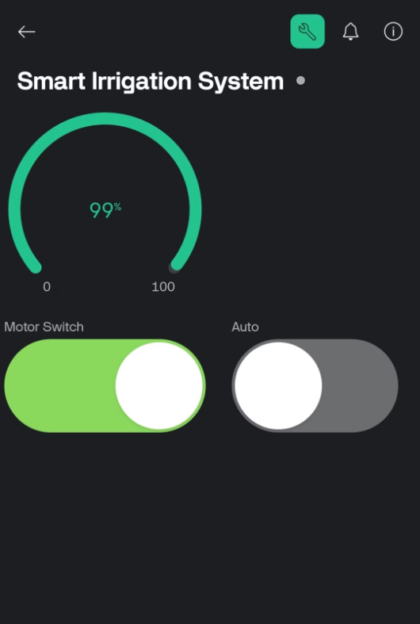
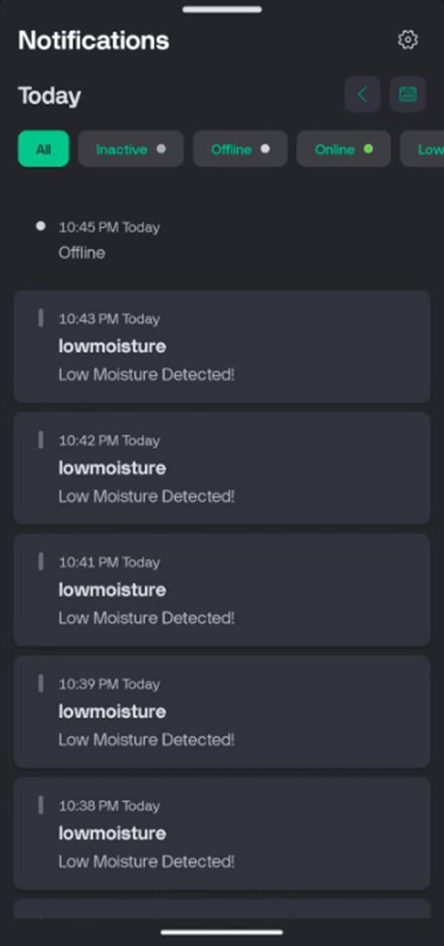
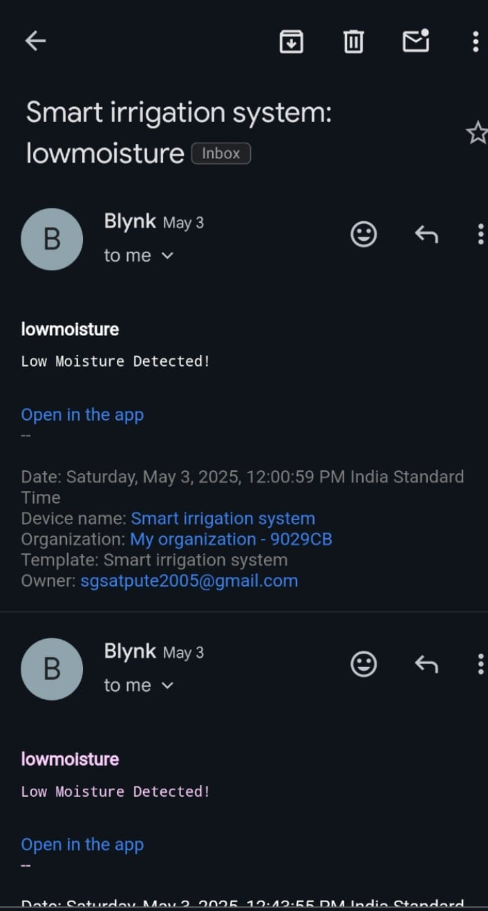

Slide 13
Code Explanation
Moisture Reading
Moisture sensor value is read using analogRead(), mapped to percentage using map().
Data Transmission
The value is sent to Blynk with Blynk.virtualWrite(V2, moisturePercent).
Automatic Control
If autoMode == true and moisture is below threshold: digitalWrite(relayPin, HIGH) is used to turn on the pump.
If autoMode == true and moisture is above threshold: Pump is turned OFF.
Alert System
If moisturePercent < 25, the following is triggered: Blynk.logEvent("low_moisture", "Warning: Soil moisture too low!").
This sends a push notification to the user via Blynk's server.

Slide 14
Output / Result
Successfully turns pump ON/OFF based on soil condition.
App interface is intuitive and responsive.
Moisture data is visible and updates live.
Alert system ensures quick response to plant needs.

Slide 15





Features
Real-time Monitoring
Real-time soil moisture monitoring
Dual Control
Supports automatic and manual control
Notifications
Sends instant low moisture notifications
Remote Access
Remote access via smartphone
Efficiency
User-friendly, low cost, and energy-efficient

Slide 16
Applications
Smart home gardening
Nursery automation
Greenhouses and polyhouses
Agriculture fields (small-scale)
College IoT projects and demos

Slide 17
Conclusion
Project demonstrates how IoT can revolutionize irrigation.
Saves water, time, and labor.
Promotes sustainable agriculture using simple technology.
Can be scaled or modified for different use cases.

Slide 18
Future Scope
Add real-time weather data integration
Use solar panels for energy autonomy
Build data analytics dashboard for long-term soil trends
Use of multiple soil sensors for large-scale farms with zone-wise control.
Integration with machine learning to predict watering needs based on crop type and soil behavior.

Slide 19
